Slide 1
Project-1: Loan Status Prediction with Python
J.charitha

Slide 2
Problem Statement:
Consider there is a finance company that gives loan for people, before approving the loan this company analysis various credentials of the persons?
# (using MACHINE LEARNING)

Slide 3
Work Flow:
1) we need some data
2) Data pre-processing
3) Split the data(train, test)
4) Support vector machine model(loan approved, rejected)

Slide 4
# Importing the dependencies
import numpy as np
import pandas as pd
import seaborn as sns
from sklearn.model_selection import train_test_split
from sklearn import svm
from sklearn.metrics import accuracy_score

Slide 5
# Data collection and processing # Loading the dataset to pandas Data Frame
loan_dataset=pd.read_csv("C:\\Users\\91939\\Downloads\\archive.zip")
type(loan_dataset)
Output: pandas.core.frame.DataFrame

Slide 6
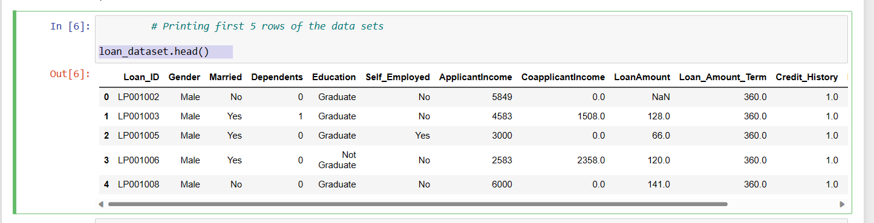
# Printing first 5 rows of the data sets
loan_dataset.head()

Slide 7
# Number of rows and columns
loan_dataset.shape
Output:(614, 13)

Slide 8
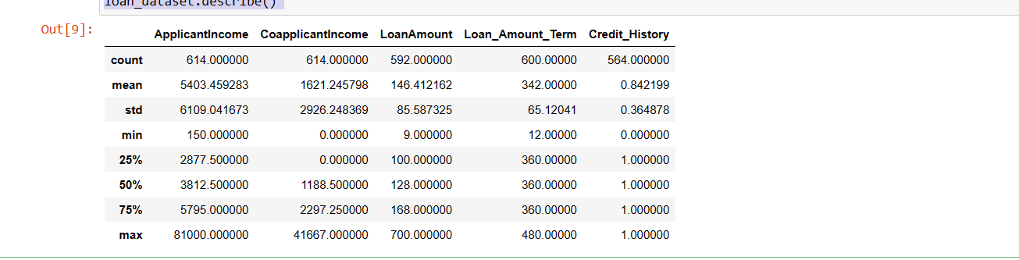
# To Print the description of data
loan_dataset.describe()

Slide 9
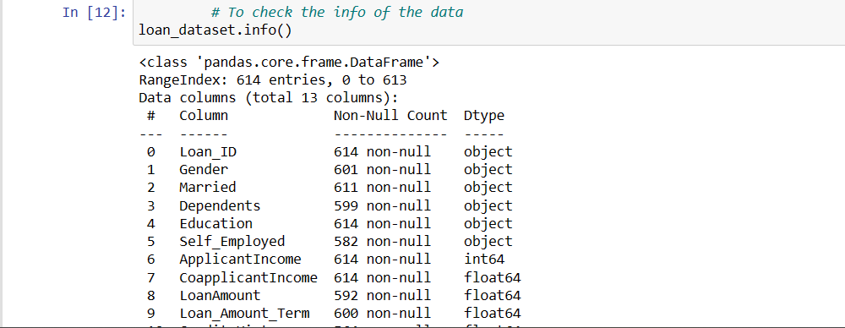
# To check the info of the data
loan_dataset.info()

Slide 10
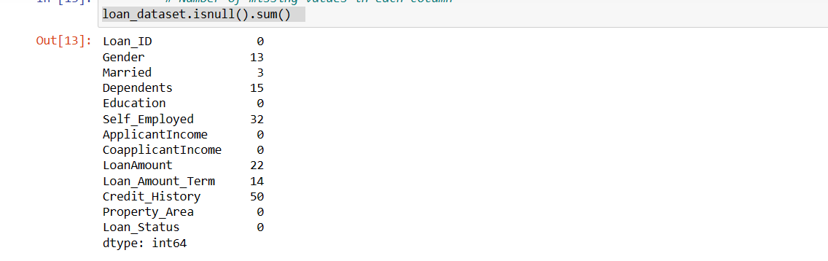
# Number of missing values in each column
loan_dataset.isnull().sum()

Slide 11
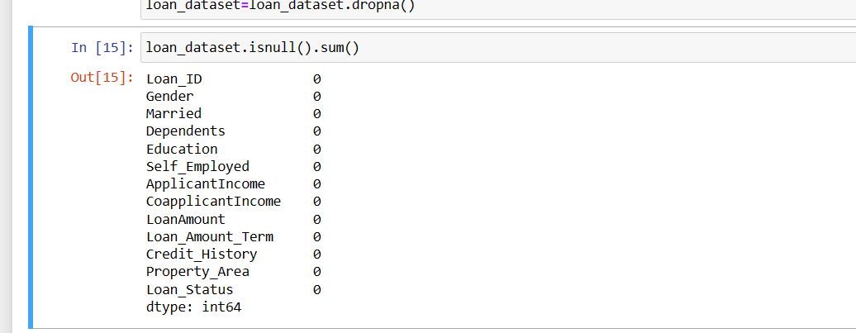
# Droping the missing values
loan_dataset=loan_dataset.dropna()

Slide 12
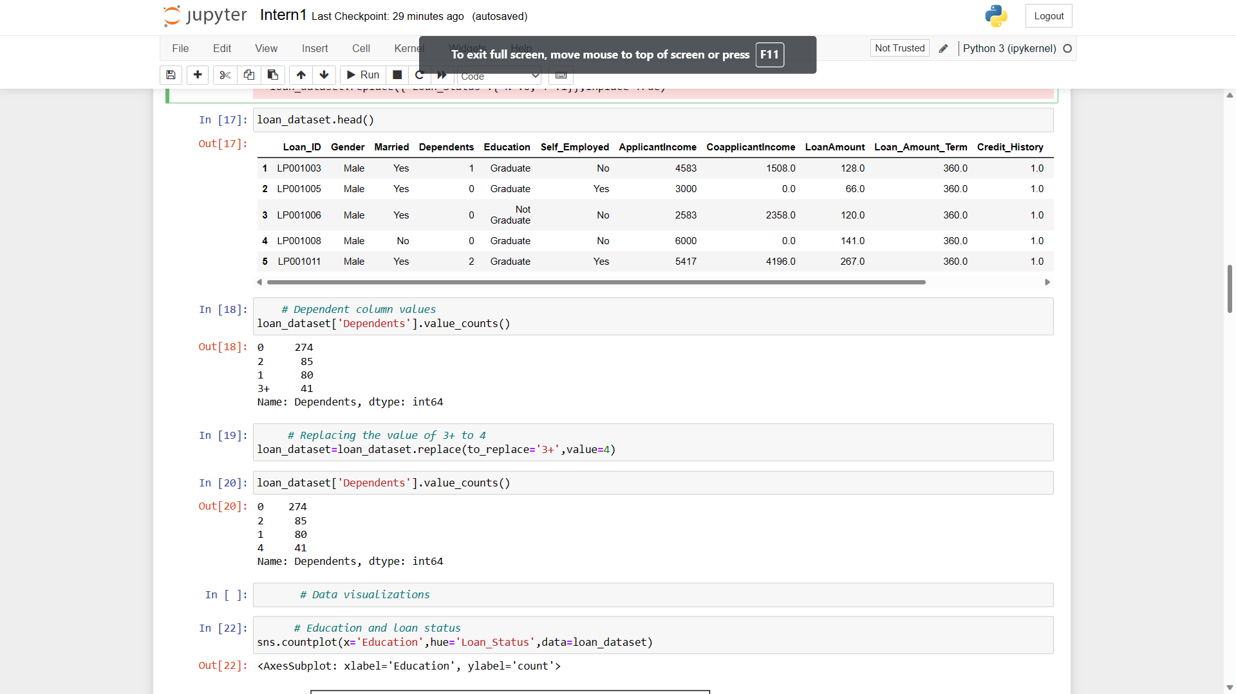
# Lable encoding
loan_dataset.replace({'Loan_Status':{'N':0,'Y':1}},inplace=True)

Slide 13
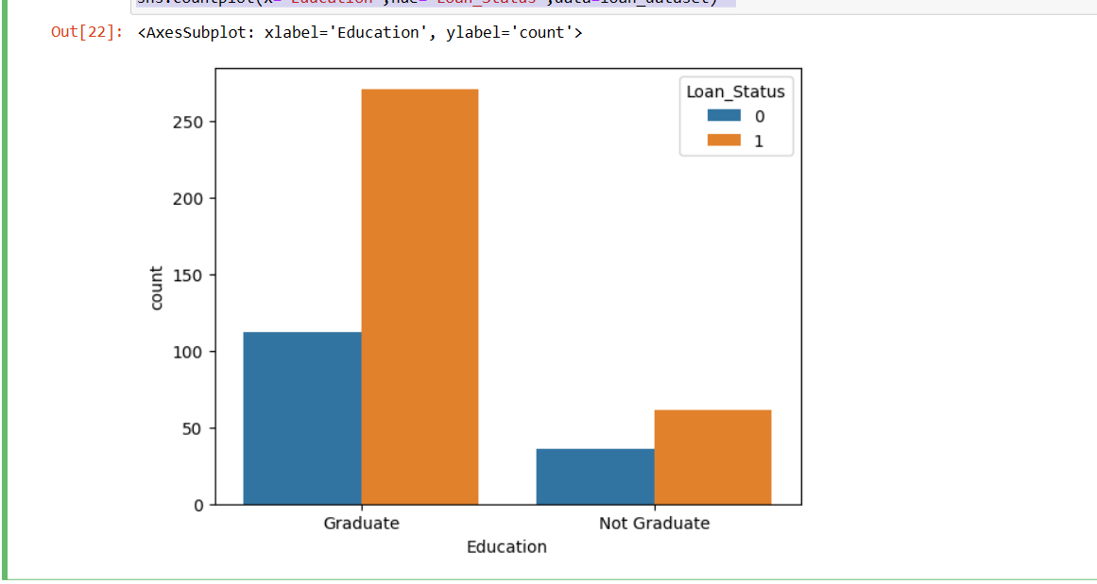
# Data visualizations
# Education and loan status
sns.countplot(x='Education',hue='Loan_Status',data=loan_dataset)

Slide 14
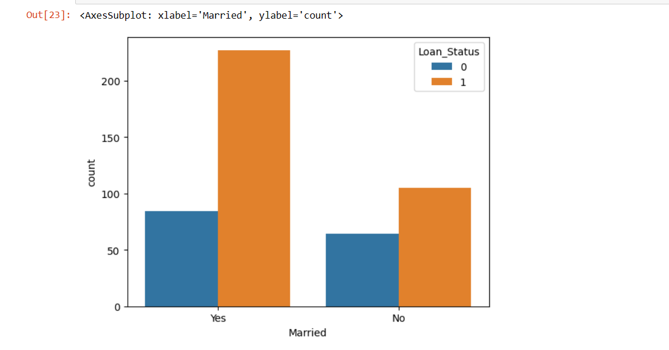
# Marital status and loan status
sns.countplot(x='Married',hue='Loan_Status',data=loan_dataset)

Slide 15
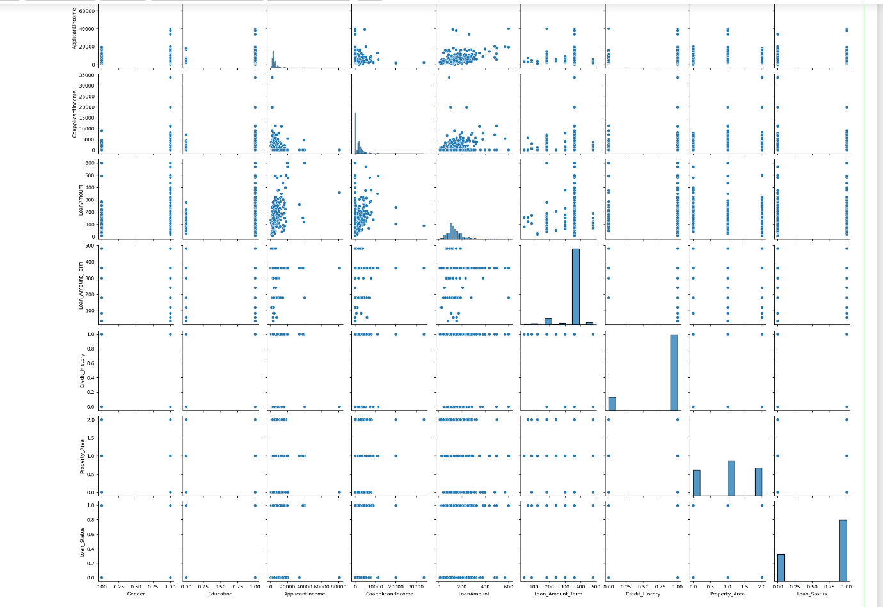
# To Make the Pairplot of our Entire Dataset in once
sns.pairplot(loan_dataset)

Slide 16
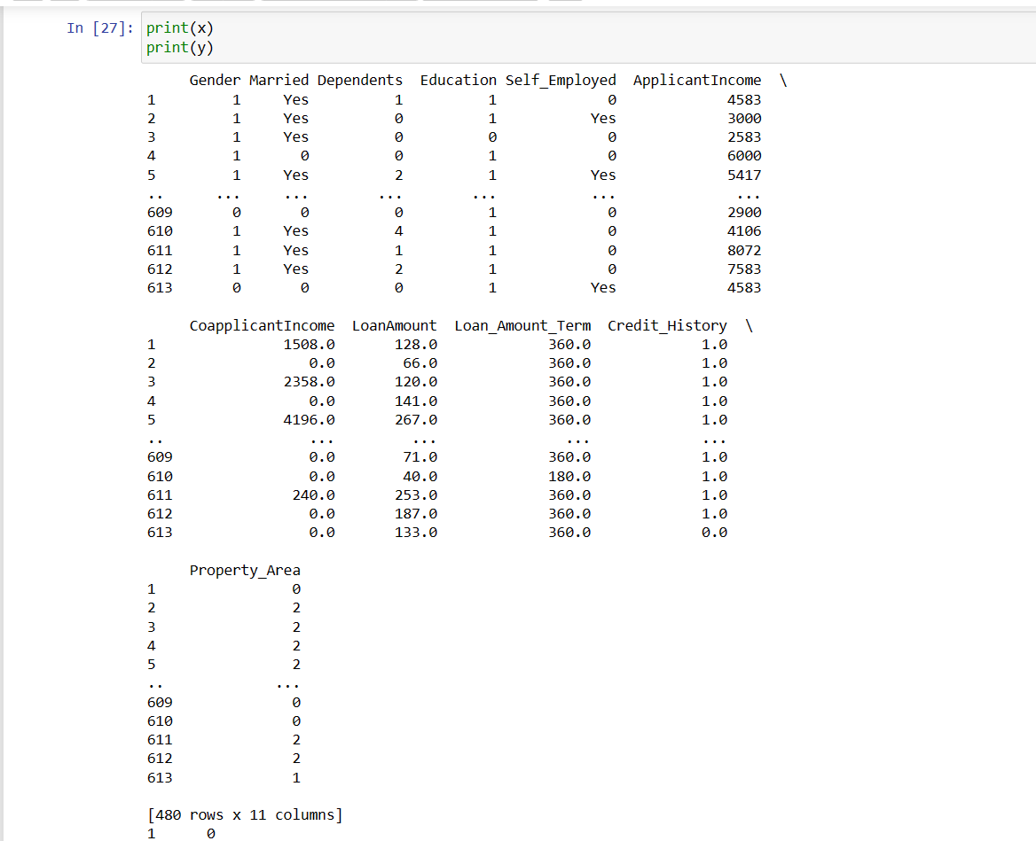
# Seperating the data and lables
x=loan_dataset.drop(columns=['Loan_ID','Loan_Status'],axis=1)
y=loan_dataset['Loan_Status']

Slide 17
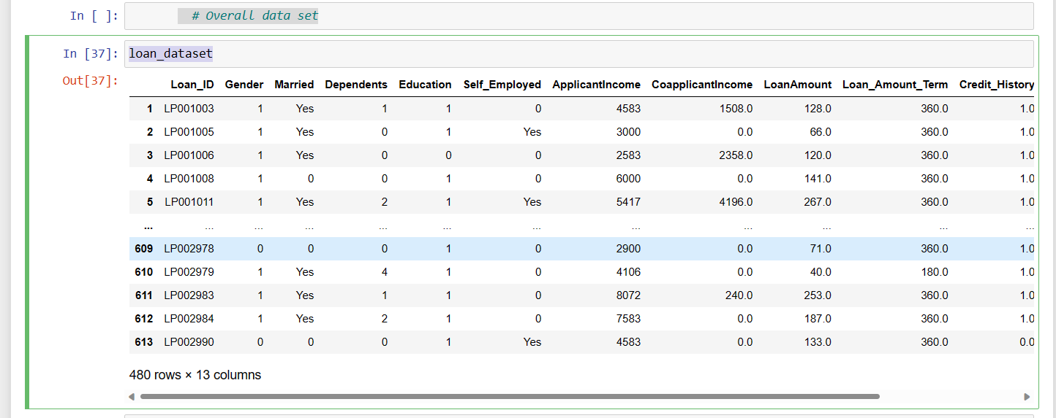
# Overall data set
loan_dataset

Slide 18
THANK YOU

